Slide 1
ELECTROMAGNETIC FIELDS
LECTURE:
MAGNETIC FORCES, MATERIALS, AND DEVICES
8.8 INDUCTORS AND INDUCTANCES

Slide 2
Self-Inductance of a circuit ($L$):
A circuit (or closed conducting path) carrying current $I$ produces a magnetic field B which causes a flux $ψ=\int{B}.dS$ to pass through each turn of the circuit (Fig. 8.16). If the circuit has $N$ identical turns, we define the flux linkage $λ$ as
$$λ=Nψ (8.53)$$
If the medium surrounding the circuit is linear, the flux linkage $λ$ is proportional to the current $I$ producing it; that is, $λ∝I$ or
$$λ=L I (8.54)$$
$L$ is a constant of proportionality called the inductance of the circuit in henry ($H$) which is the same as W$b/$amps. A circuit or part of a circuit that has inductance is called an inductor.

Slide 3
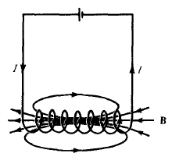
Inductance $\left(L\right)$ of an inductor: is define as the ratio of the magnetic flux linkage $λ$ to the current $I$ through the inductor; $L=\frac{λ}{I}=\frac{Nψ}{I} (8.55)$
The magnetic energy $W_{m}$ (joules) stored in an inductor is as:
$W_{m}=\frac{1}{2} L I^{2} (8.56)$
$L=\frac{2 W_{m}}{I^{2}} (8.57)$

Slide 4
Mutual inductance ($M$):
If two circuits carrying current $I_{1}$ and $I_{2}$ as in Fig. 8.17, a magnetic interaction exists between the circuits. Four component fluxes $ψ_{11}$, $ψ_{12}$, $ψ_{21}$, and $ψ_{22}$ are produced. The flux $ψ_{12}$, is the flux passing through circuit 1 due to current $I_{2}$ in circuit 2. If $B_{2}$ in the field due to $I_{2}$ and $S_{1}$ is the area of circuit 1, then
$$ψ_{12}=\int_{S_{1}}{B_{2}}. dS (8.58)$$
Mutual inductance $M_{12}$: is define as the ratio of the flux linkage $λ_{12}=N_{1}ψ_{12}$ on circuit 1 to current $I_{2}$, that is,
$$M_{12}=\frac{λ_{12}}{I_{2}}=\frac{N_{1}ψ_{12}}{I_{2}} (8.59a)$$

Slide 5
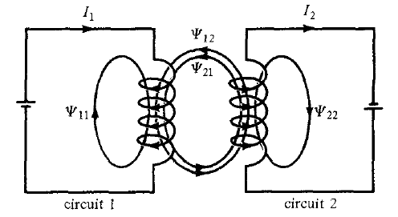
Figure 8.18 Magnetic interaction between two circuits.

Slide 6
Similarly, the mutual inductance $M_{21}$ is defined as the flux linkages of circuit 2 per unit current $I_{1}$; that is,
$$M_{21}=\frac{λ_{21}}{I_{1}}=\frac{N_{2}ψ_{21}}{I_{1}} (8.59b)$$
in the absence of ferromagnetic material
$$M_{12}=M_{21} (8.59c)$$
the self-inductance of circuits 1 and 2, respectively, as
$$L_{1}=\frac{λ_{11}}{I_{1}}=\frac{N_{1}ψ_{1}}{I_{1}} \left(8.60\right) and L_{2}=\frac{λ_{22}}{I_{2}}=\frac{N_{2}ψ_{2}}{I_{2}} (8.61)$$
Where $ψ_{1}=ψ_{11}+ψ_{12} and ψ_{2}=ψ_{22}+ψ_{21}$

Slide 7
The total energy in the magnetic field is the sum of the energies due to $L_{1}$, $L_{2}$ and $M_{12}$ (or $M_{21}$); that is,
$$W_{m}=W_{1}+W_{2}+W_{12}=\frac{1}{2}L_{1}I_{1}^{2}+\frac{1}{2}L_{2}I_{2}^{2}±M_{12} I_{1}I_{2} (8.62)$$
The positive sign is taken if the magnetic fields of the two circuits strengthen each other and negative sign is taken if the magnetic fields oppose each other.
In an inductor such as a coaxial or a parallel-wire transmission line, the inductance produced by the flux internal to the conductor is called the internal inductance $L_{in}$, while that produced by the flux external to it is called external inductance $L_{ext}$. The total inductance $L$ is
$$L=L_{in}+L_{ext} (8.63)$$

Slide 8
8.9 MAGNETIC ENERGY
The energy is stored in the magnetic field of the inductor.
$$W_{m}=\frac{1}{2} L I^{2} (8.56)$$
To express equation (8.56) in terms of B or H consider a differential volume in a magnetic field as in Fig. 8.19. Let the volume be covered with conducting sheets at the top and bottom surfaces with current $ΔI$.

Slide 9
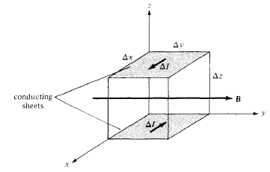
Fig. 8.19 A differential volume in a magnetic field.

Slide 10
We assume that the whole region is filled with such differential volumes. From equation (8.55), each volume has an inductance
$$ΔL=\frac{Δψ}{ΔI}=\frac{µH ΔxΔz}{ΔI} (8.64)$$
where $ΔI=HΔy$. Substituting equation (8.64) into eq. (8.56), we have
$${ΔW}_{m}=\frac{1}{2} ΔL ΔI^{2}=\frac{1}{2} µ H^{2} ΔxΔyΔz (8.65a)$$
or
$${ΔW}_{m}=\frac{1}{2} µ H^{2} Δv (8.65b)$$

Slide 11
The magnetostatic energy density $W_{m}$ ($in J/m^{3}$) is defined as
$$W_{m}=\lim_{Δv→0}{\frac{{ΔW}_{m}}{Δv}}=\frac{1}{2} µ H^{2}$$
$$W_{m}=\frac{1}{2} µ H^{2}=\frac{1}{2} B.H=\frac{B^{2}}{2µ} (8.66)$$
Thus the energy in a magnetostatic field in a linear medium is
$$W_{m}=\int{W_{m} dv}$$
$$W_{m}=\frac{1}{2}\int{B .H dv}=\frac{1}{2}\int{µ H^{2} dv} (8.67)$$

Slide 12
Table 8.2 a collection of formulas for inductance of common elements

Slide 13
8.10 MAGNETIC CIRCUITS
Magnetic devices such as toroids, transformers, motors, generators, and relays may be considered as magnetic circuits. The analysis of such circuits is made simple if an analogy between magnetic circuits and electric circuits is exploited. The analogy between magnetic and electric circuits is summarized in table 8.3 and portrayed in Figure 8.20.
We define the magnetomotive force (mmf) $ℱ$ (in ampere-turns) as
$$ℱ=NI=\oint{H. dL} (8.68)$$
We also define reluctance $ℛ$ (in ampere-turns$/$weber) as
$$ℛ=\frac{𝓁}{µS} (8.69)$$

Slide 14
Table 8.3: Analogy between Electric and Magnetic Circuits
Electric Field | Magnetic Field
Conductivity $σ$ Field intensity $E$ Current $I=\int{\overset{⃑}{J}. dS}$ Current density $J=\frac{I}{S}=σE$ Electromotive force (emf) $V$ Resistance $R$ Conductance $G=\frac{1}{R}$ Ohm's law $R=\frac{V}{I}=\frac{𝓁}{σS}$ or $V=E𝓁=IR$ Kirchoff's laws: $\sum{I=0}$ $\sum{V}−\sum{IR}=0$ | Permeability $µ$ Field intensity $H$ Magnetic flux $ψ=\int{B. dS}$ Flux density $B=\frac{ψ}{S}=µH$ Magnetomotive force (mmf) $ℱ$ Reluctance $ℛ$ Permeance $𝓅=\frac{1}{ℛ}$ Ohm's law $ℛ=\frac{ℱ}{ψ}=\frac{𝓁}{µS}$ or $ℱ=H𝓁=ψℛ=NI$ Kirchhoff's laws: $\sum{ψ=0}$ $\sum{ℱ}−\sum{ψℛ}=0$

Slide 15
The basic relationship for circuit elements is Ohm's law ($V=IR$):
$$ℱ=ψℛ (8.70)$$
The rules of adding voltages and for combining series and parallel resistances also hold for mmfs and reluctances. for $n$ magnetic circuit elements in series
$$ψ_{1}=ψ_{2}=ψ_{3}=…=ψ_{n} (8.71)$$
and
$$ℱ=ℱ_{1}+ℱ_{2}+ℱ_{3}+…+ℱ_{n} (8.72)$$
For $n$ magnetic circuit elements in parallel,
$$ψ=ψ_{1}+ψ_{2}+ψ_{3}+…+ψ_{n} (8.73)$$
and
$$ℱ_{1}=ℱ_{2}=ℱ_{3}=…=ℱ_{n} (8.74)$$

Slide 16
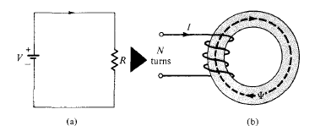
Figure 8.20 Analogy between (a) an electric circuit, and (b) a magnetic circuit.

Slide 17
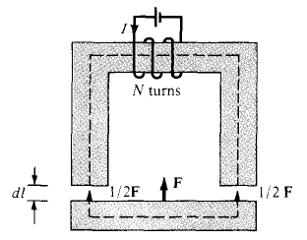
8.11 FORCE ON MAGNETIC MATERIALS
The magnetic force is useful in electromechanical systems such as electromagnets, relays, rotating machines, and magnetic levitation. Consider, an electromagnet made of iron as shown in Fig. 8.21.

Slide 18
The work required to effect the displacement is equal to the change in stored energy in the air gap is:
$$−FdL=dW_{m}=2\left[\frac{1}{2}\frac{B^{2}}{µ_{o}}S dl\right] (8.75)$$
where
S is the cross-sectional area of the gap,
the factor 2 accounts for the two air gaps, and
the negative sign indicates that the force acts to reduce the air gap (or that the force is attractive). Thus

Slide 19
$$F=−2\left[\frac{B^{2}S}{2µ_{o}}\right] (8.76)$$
The tractive force across a single gap can be obtained from eq. (8.75) as
$$F=− \frac{B^{2}S}{2µ_{o}} (8.77)$$
Equation (8.77) can be used to calculate the forces in many types of devices including relays, rotating machines, and magnetic levitation.
The tractive pressure (in $N/m^{2}$) in a magnetized surface is
$$P=\frac{F}{S}=\frac{B^{2}}{2µ_{o}}=\frac{1}{2} BH (8.78)$$
Which is the same as the energy density $w_{m}$ in the air gap.

Slide 20
Figure 8.22 B-H curves, $H<400A/m$.

Slide 21
Figure 8.23 B-H curves, $H>400A/m$

